Slide 1
Understanding and supporting today’s college student:
Special focus on mental health
Aaron Krasnow, Ph.D.
Associate Vice President
ASU Counseling and Health Services

Slide 2
Let’s play
Guess the Generation!

Slide 3
“Young people these days are…”
Too close to their parents
Too entitled in their opinions
Feeling misunderstood
Too focused on technology
Poor communicators
Naïve

Slide 4
Guess the Generation!
Your choices are:
GI Generation (1901-1924)
Silent (1925-1944)
Baby Boomers (1945-1963)
Generation X (1964-1980)
Millennial (1981-2000)
Generation Z (2001 – 20xx)

Slide 5
“Young people these days are…”
Too close to their parents
Too entitled in their opinions
Feeling misunderstood
Too focused on technology
Poor communicators
Naïve
Choices:
G.I., Silent, Baby Boomer, Generation X, Millennial, Generation Z

Slide 6
Answer…
G.I. Generation
and Silent
and Baby Boomer
and Generation X
and Millennial and Generation Z

Slide 7
Guess the generation…
Independent-minded
Focused on community over self
Cynical about the future due to chaotic domestic/global issues
Idealistic
Hopeful
Activist
See self as agent of change
Choices: G.I., Silent, Baby Boomer, Generation X, Millennial, Generation Z

Slide 8
Answer…
Generation Z
and Millennial
and Generation X
and Baby Boomer
and Silent and G.I.

Slide 9
Talking ‘bout my generation…
Independent-minded
Focused on community over self
Cynical about the future due to chaotic domestic/global issues
Idealistic
Hopeful
Activist
See self as agent of change

Slide 10
Generational stereotypes…
Confirmation bias – Tendency to search for or interpret information in a way that confirms one’s preconceptions.
Vividness effect – vivid or dramatic instances affect perception of a circumstance.
Availability heuristic – mental shortcut that relies on immediate examples when evaluating a topic.
Ethnocentrism – the belief that one’s personal ethnic or cultural lens is better (or at least the norm).

Slide 11
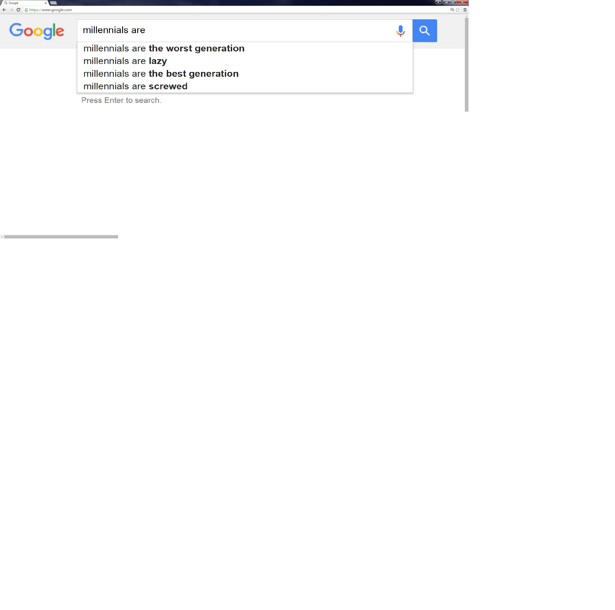
Millennials are…

Slide 12
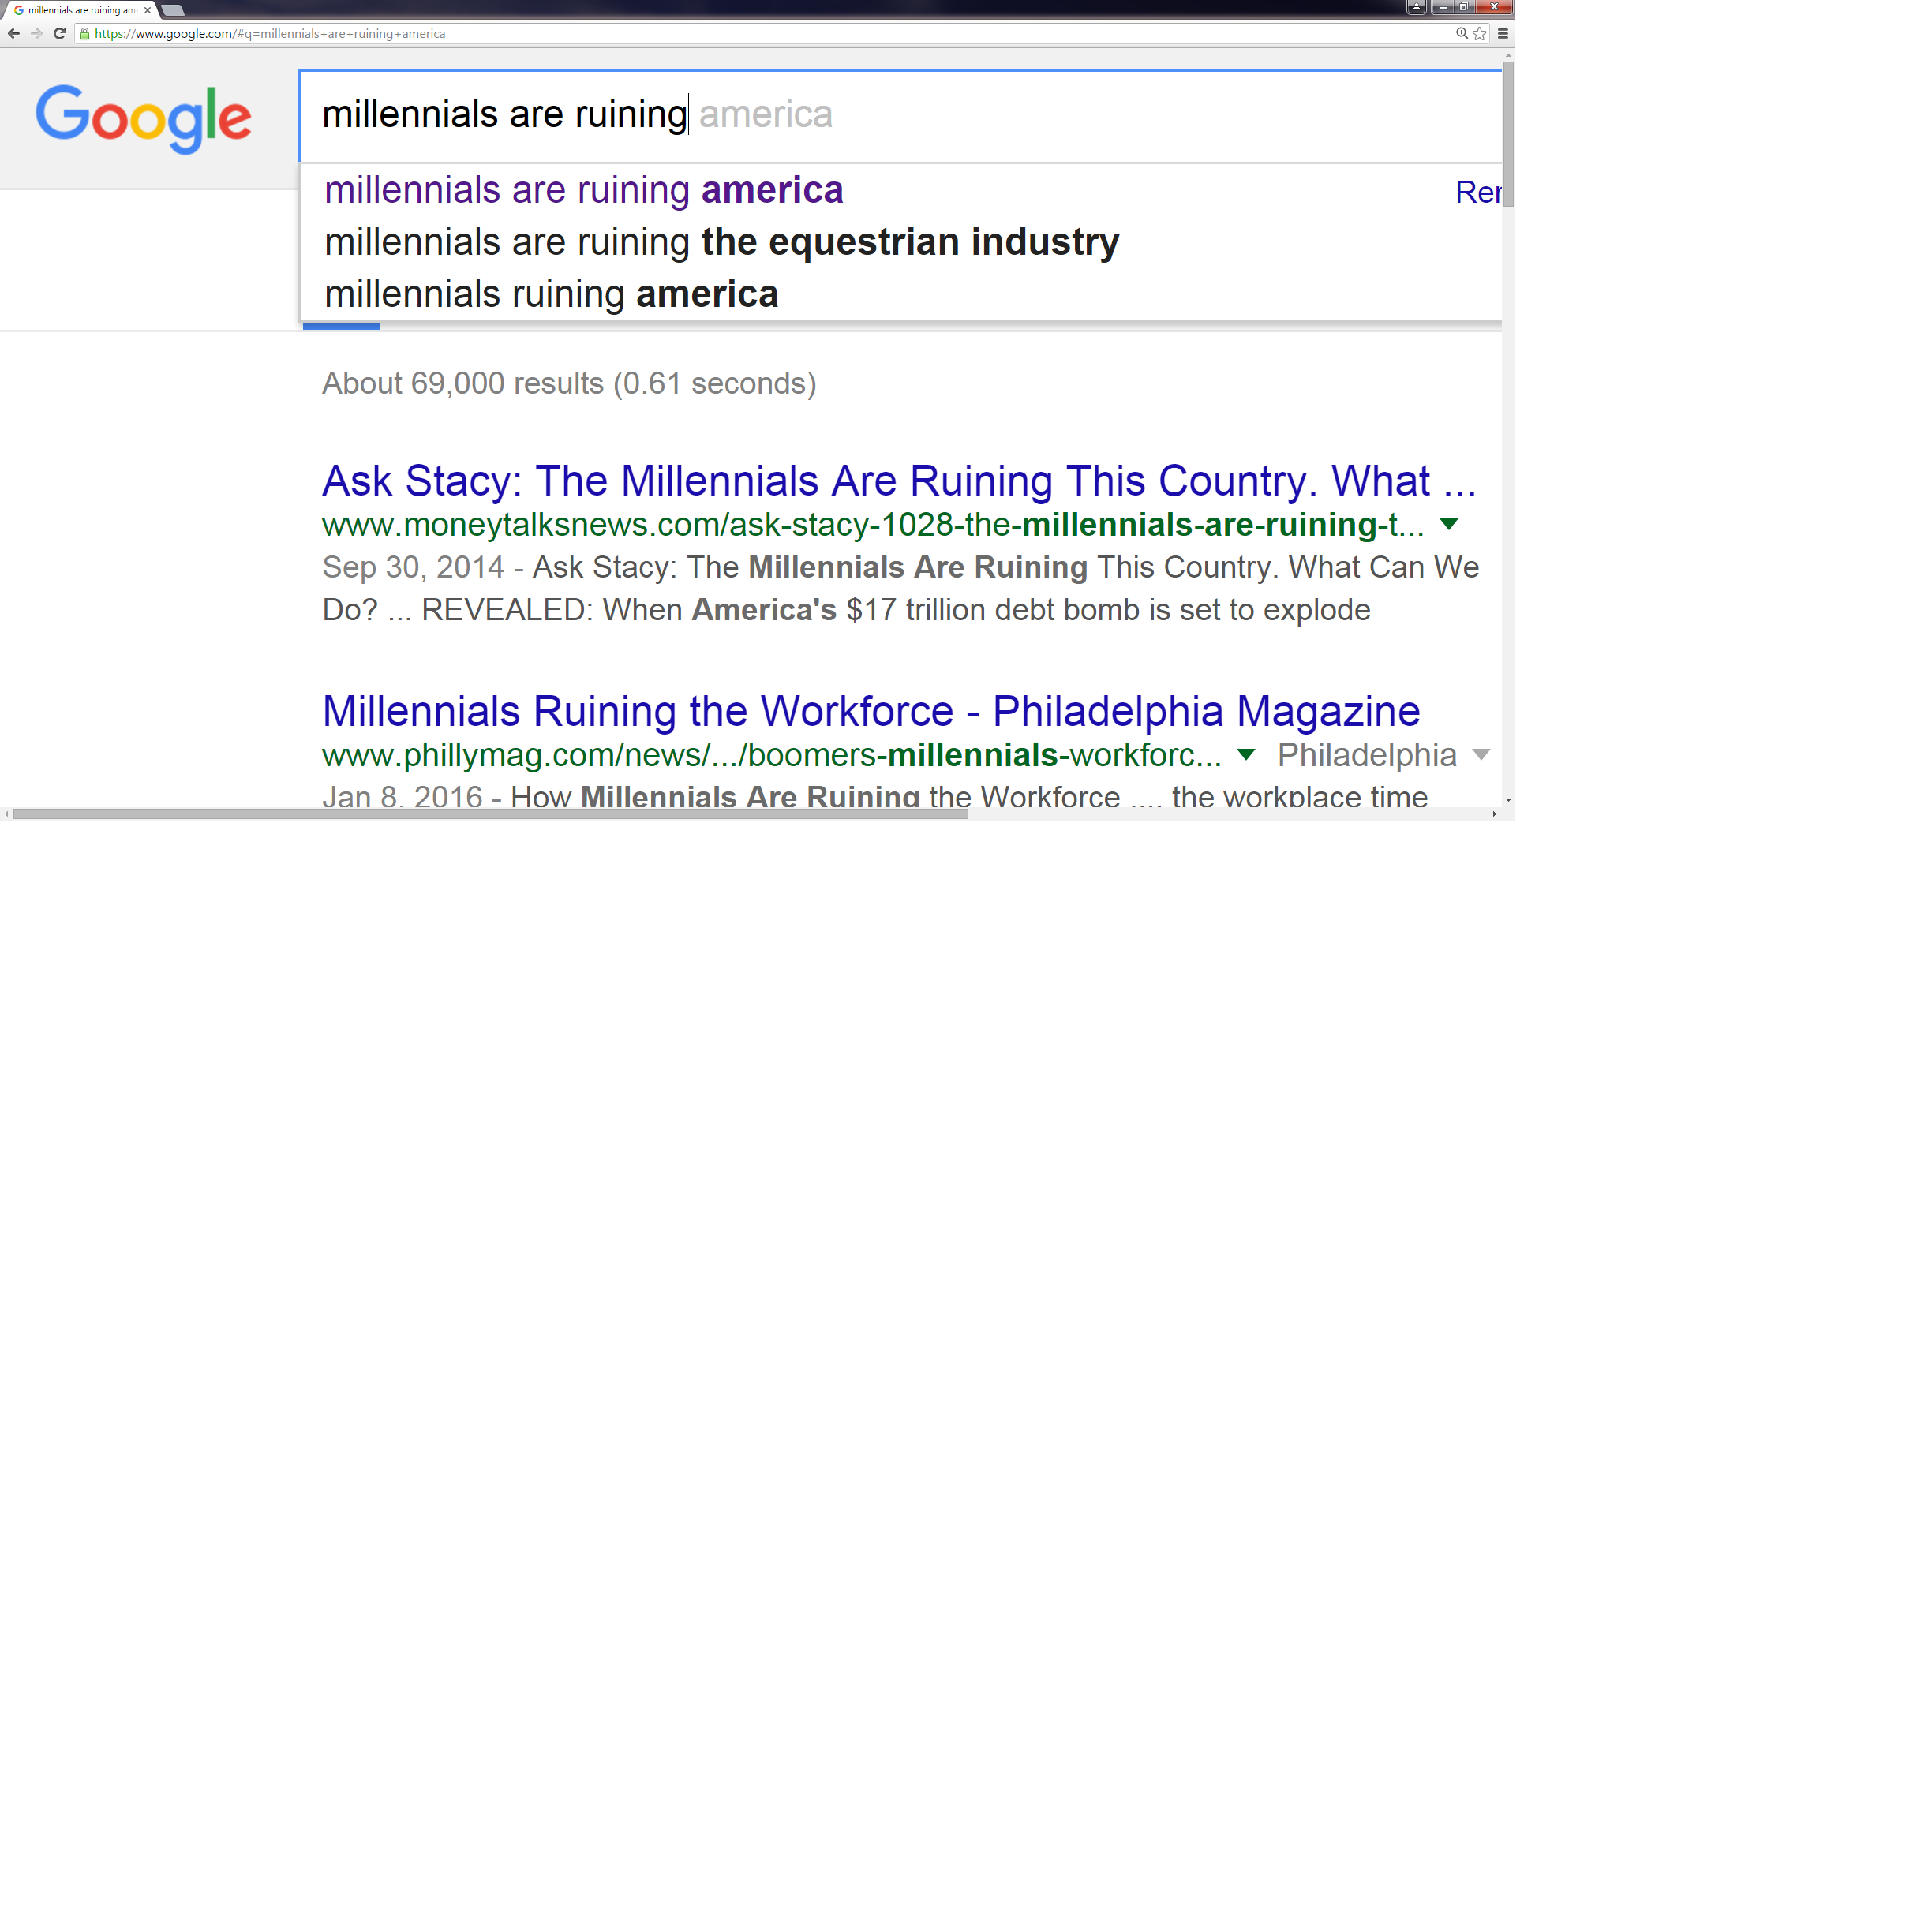
Millennials are…

Slide 13
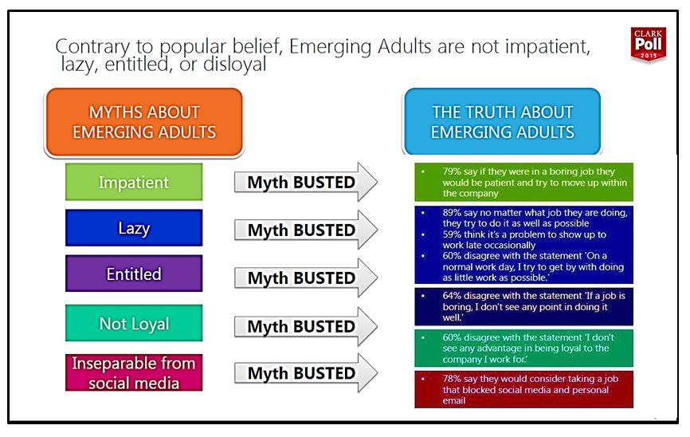
Millennials are…

Slide 14
Real strengths of today’s
college student…
Diversity and inclusivity minded
Trusting of positive authority
Purpose driven
Hopeful
Have emotion language

Slide 15
Real challenges…
Uncertainty in economy
Some poorer health outcomes
The double-edge of interconnectedness
Stereotype threat
Increasing prevalence of mental health issues

Slide 16
Mental Health and College Students
It’s real.
It’s related to high school and college success.
It’s related to the reasons students drop out.
The media is paying attention.

Slide 17
NAMI.org

Slide 18
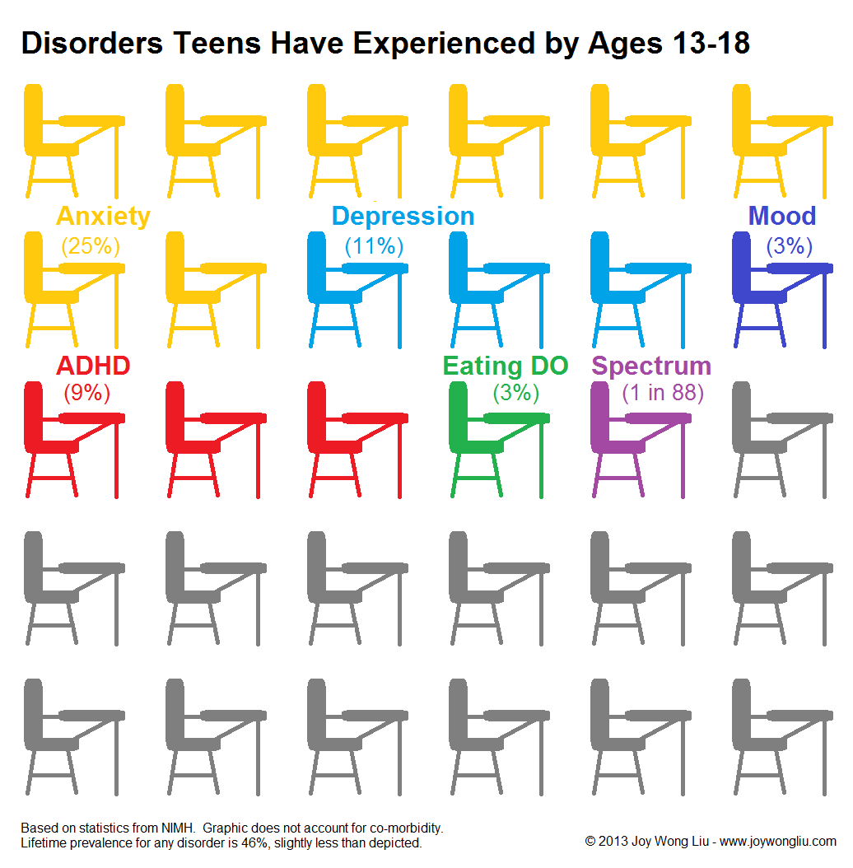

Slide 19
Median age at the onset of mental health disorder
Type of disorder | Median age at Onset
Any disorder | 14 (7-24)
Anxiety disorder | 11 (6-21)
Mood disorder | 30 (18-43)
Impulse-control disorder | 11 (7-15)
Substance-use disorder | 20 (18-27)
Kessler et al.

Slide 20
It’s real
Collegiate mental health is a specific and growing area of research and practice:
Center for Collegiate Mental Health (CCMH)
Association of University and College Counseling Center Directors (AUCCCD)
American College Health Association (ACHA)
National Research Consortium of Counseling Centers in Higher Education (The Research Consortium)

Slide 21
CCMH 2009-2015
The growth in the number of students seeking counseling was more than 5x the rate of enrollment growth.
Lifetime prevalence rates for prior mental health services remain unchanged:
  Prior counseling (1 in 2)
  Prior psychiatric medication (1 in 3)
  Prior hospitalizations (1 in 10)

Slide 22
CCMH 2009-2015
Depression, Anxiety, and Social Anxiety show increasing prevalence in counseling center clients.
Lifetime prevalence rate for non-suicidal self-injury (NSSI) has increased from 21.8% to 25.0%
Lifetime prevalence rate for serious suicidal ideation has increased from 23.8% to 32.9%
Lifetime prevalence rate for “attempted suicide” remains unchanged (current: 9.5%).

Slide 23
ACHA-NCHA II – Spring 2015
National research survey
Undergraduates and graduate students
Random sample
108 institutions
74,438 undergraduate students surveyed

Slide 24
Academic Interference
Factor | Rate
Stress | 32.5%
Anxiety | 23.4%
Sleep | 22.0%
Cold/Flu/Sore Throat | 16.2%
Depression | 14.8%
Work | 14.7%
Internet Use | 12.5%
Finances | 7.1%

Slide 25
Depression and Anxiety symptoms
Factor | 30 days | 12 months
Overwhelmed | 69.1% | 86.7%
Exhausted (not from activity) | 67.1% | 82.4%
Sad | 41.5% | 65.1%
Lonely | 39.2% | 60.5%
Overwhelming anxiety | 37.3% | 57.7%
Felt things were hopeless | 28.5% | 49.5%
Depressed can’t function | 19.2% | 35.3%

Slide 26
Suicidality
Factor | 30 days | 12 months
Seriously considered | 3.6% | 9.8%
Intentionally harmed (NSSI) | 3.0% | 7.1%
Attempted suicide | 0.5% | 1.6%

Slide 27
Mental health and retention
Psychological adjustment predicts retention.
  Gerdes & Mallinckdrodt, 1994
Receiving counseling predicts retention beyond wanting but not receiving counseling.
    Wilson et al., 1997
Students who have received counseling retain at a higher rate.
    Turner & Berry, 2000
5% of students end their education due to mental health disorders
    Kessler et al., 1995

Slide 28
The media is paying attention
Suicide on Campus and the Pressure of Perfection
- New York Times, July 27, 2015
When Mentally Ill Students Feel Alone
- The Atlantic, March 2, 2015
To Prevent Suicides in College Make Mental Health Screenings Mandatory (Opinion)
- Washington Post, December 21, 2015
College of the Overwhelmed
- Book, Richard Kadison, 2004

Slide 29
What most colleges are doing
Each year between 2011 and 2015 nearly 60% of colleges reported increasing budgets for professional counselor/psychologists.
Garrett Lee Smith Memorial Act – SAMHSA grants.
Jed Foundation Campus Programs.
Training advising, faculty, staff, housing, gate-keepers.
Behavioral Intervention Teams.

Slide 30
What the best colleges are doing
Comprehensive services:
  Counseling and Health Services staffed by professionals
  Physical activity/fitness
  Nutrition is valued
  Volunteering/service culture
Developmentally appropriate services:
  An articulated focus on college health
  Outsourced health models are rarely developmentally appropriate
Valuing diversity:
  Colleges that value diversity are likely to affirm and support students who feel “different” than others. This predicts good outcomes in mental health.

Slide 31
How do these issues affect aid administrators?
Increased parental involvement
Traditional administrative and economic systems mismatched to current student experience.
Professional-employee and student-employee factors
Increased “demandingness”
Increased crises or “crises”
Difficulty with “follow-through”

Slide 32
Recommendations for aid teams…
Training in facts about emerging adults
  Emerging Adulthood: Jeffrey Arnett
Training in human motivation
  Motivational interviewing
  Autonomy support
Training in emotional intelligence skills
  E.I. for financial advisors and planners - Dubofsky, D., & Sussman, L. (2009).
Emphasize strengths-based human-centeredness, not generational stereotypes.

Slide 33
Strengths-based human-centered strategies
For motivation:
Connect their need to their community
Model positive authority
Give clear statements about meaningfulness
Allow and support emotionality into the conversation

Slide 34
Strengths-based human-centered strategies
For connecting to help and resources:
Model hopefulness
Ask their ideas
Emphasize immediacy
Reinforce the connection between seeking help and their goals

Slide 35
How else do these issues affect you as aid administrators?

Slide 36
Thank you!

